Slide 1
Kevin’s Facility Plan
My Woodworking Dream Lab

Slide 2
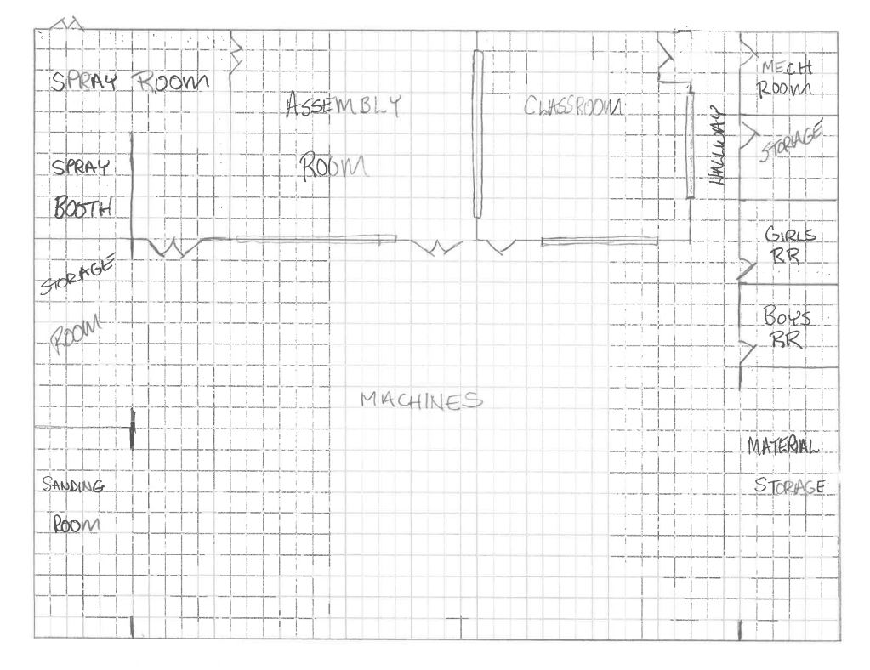
F l o o r P l a n
My floor plan shows a layout of the rooms as I would have them in a perfect world.
I have added lots of storage
I have isolated some of the activities to make it cleaner and more safe
I have used windows in the classroom and assembly labs to allow better supervision

Slide 3
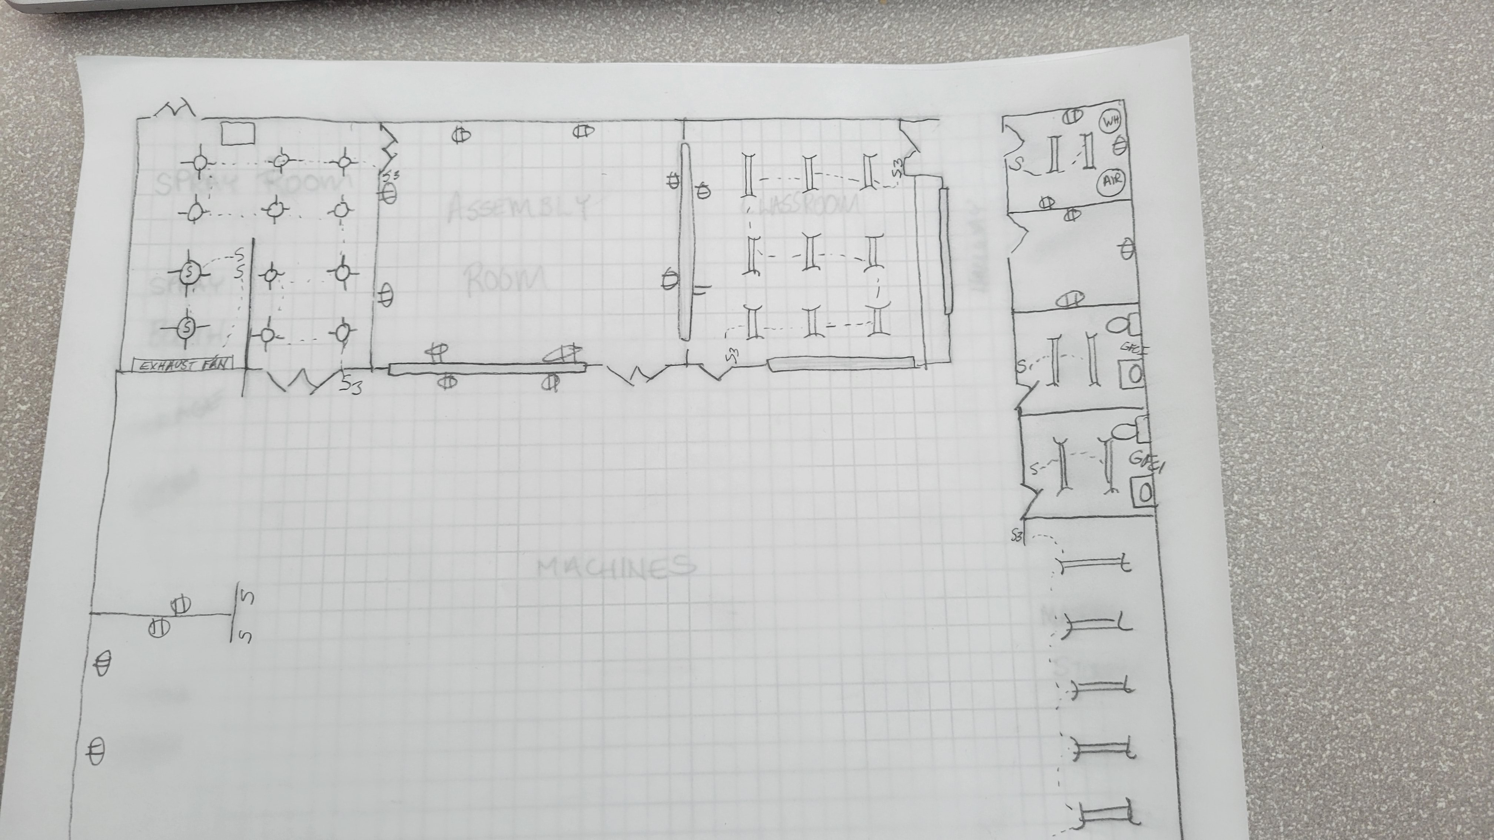
F l o o r P l a n
This layer of the drawing shows the electrical components, including outlets and lighting.
I wanted to have plenty of outlets and the electrical in the spray room is explosion proof, which costs more.

Slide 4
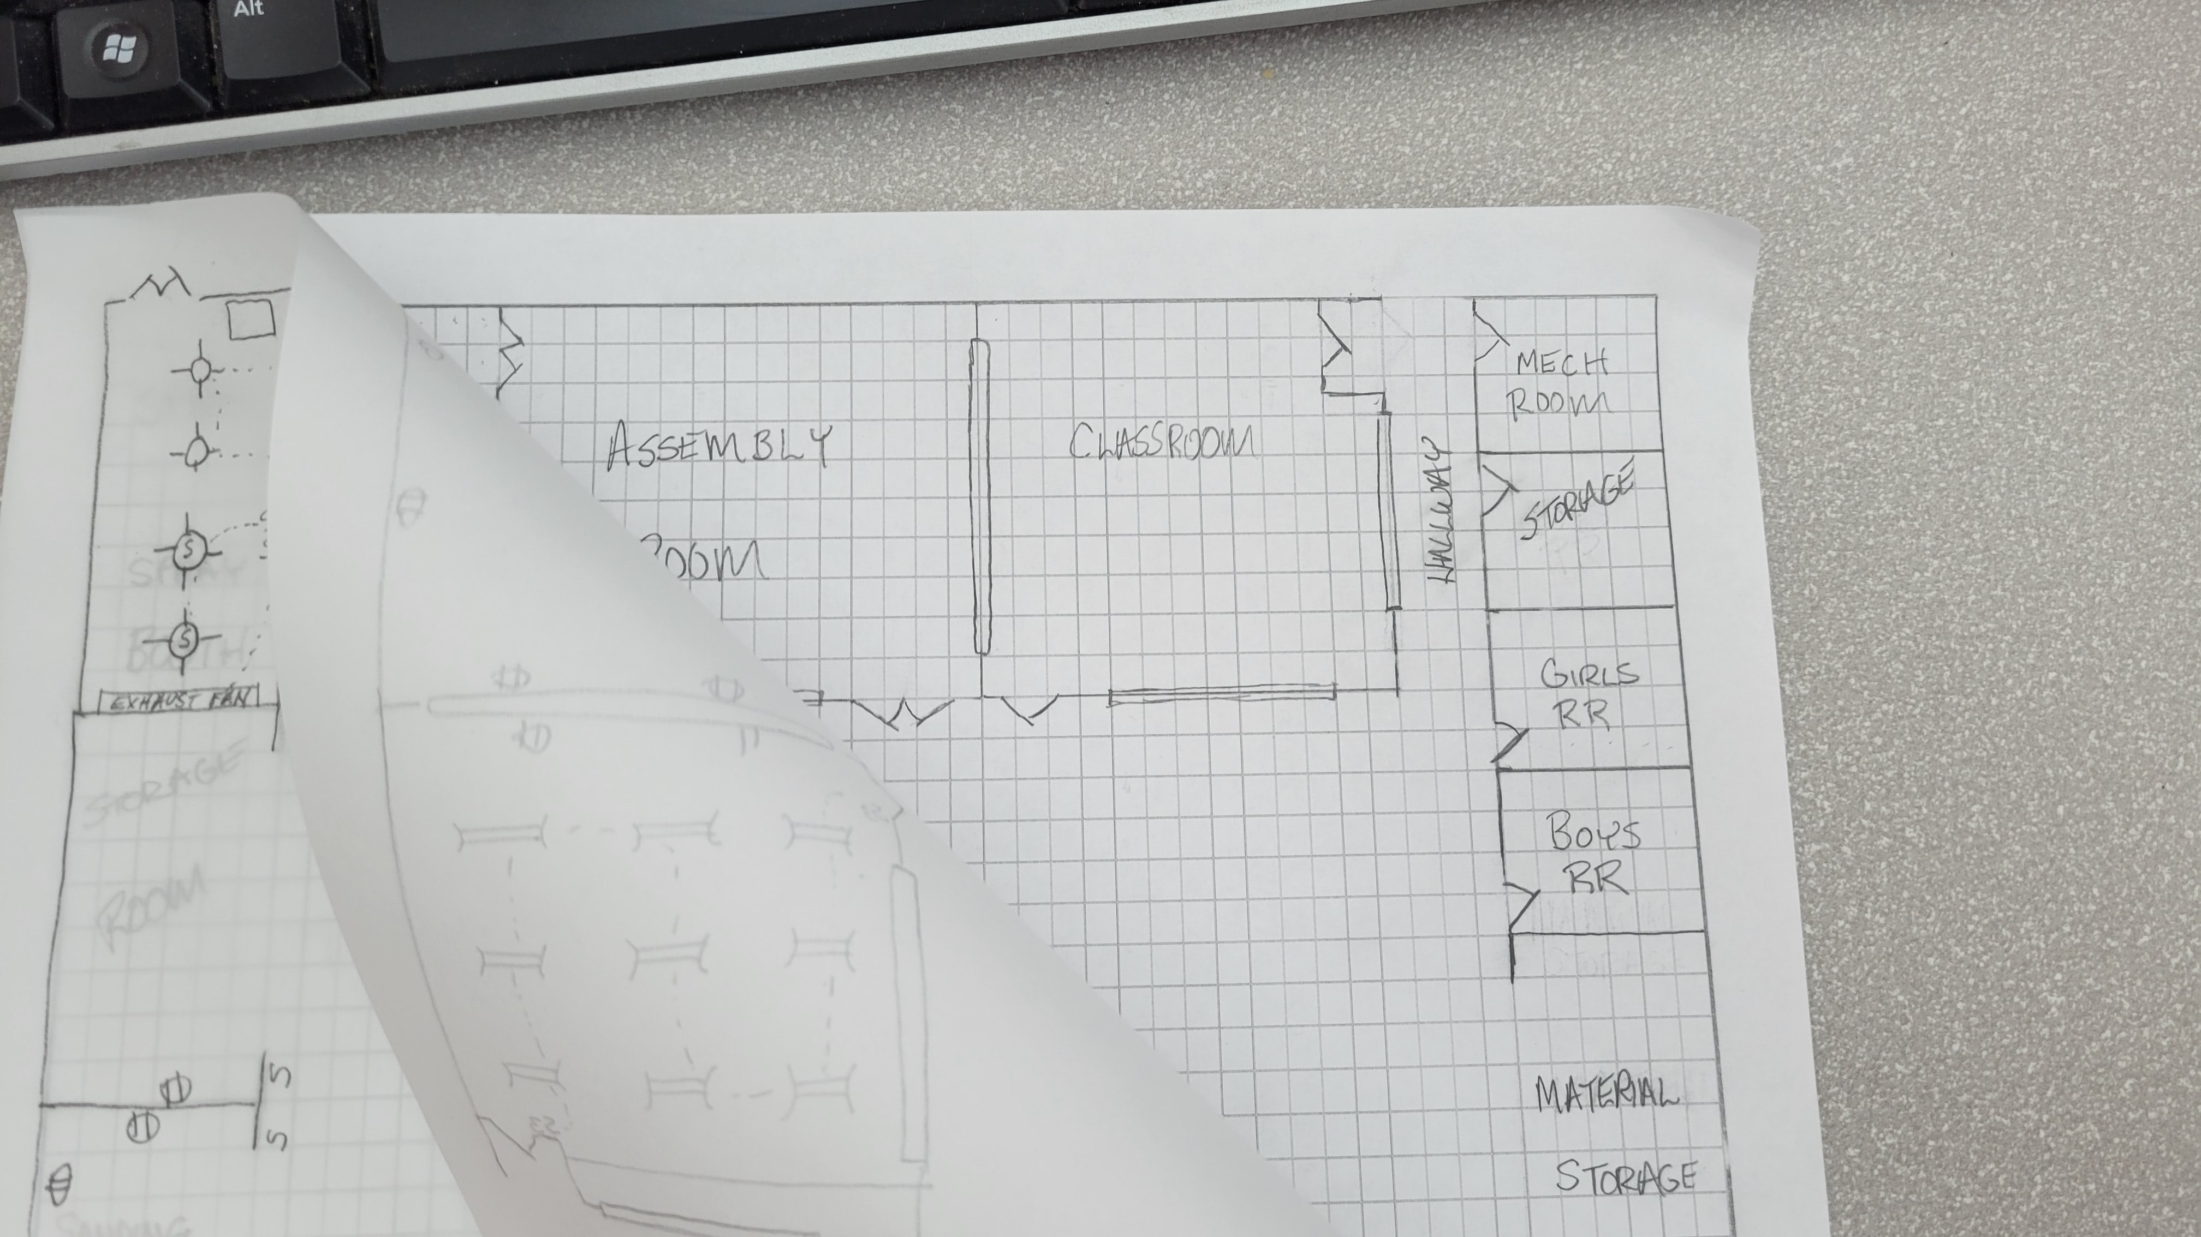
F l o o r P l a n

Slide 5
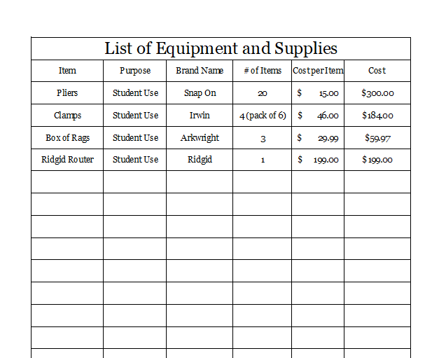
Kevin’s Facility Plan
The Items on this list are essential to the function of the classroom and laboratory areas.
Focus should be on items you seem to run short of (like the clamps) or new tools for new projects or activities.
This list is not complete, it is to provide an example. However, when it is completed it is a great item to share with your Administrator in case they come up with a little extra money in June!!
List of Essential Needs

Slide 6
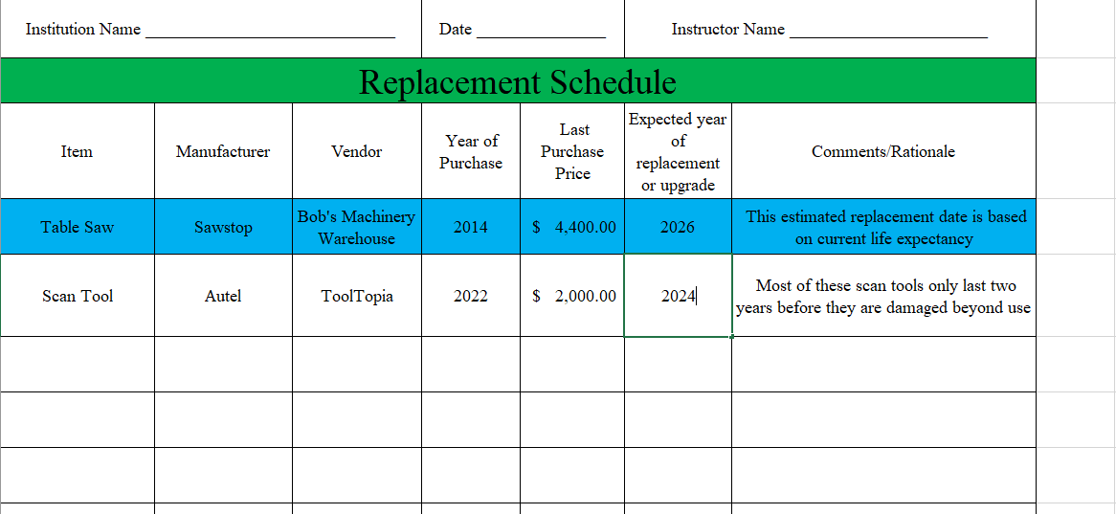
Kevin’s Facility Plan
The Items on this list are essential to the function of the classroom and laboratory areas.
In this file, you are doing multiple things.
Documenting Maintenance schedules
Listing when certain items might need replaced. Many items wear out with student use and sharing when you expect to replace them can be valuable later
Inventory for fire, theft, and insurance purposes
The consumables can include many things that you have to replace on a regular basis
Maintenance, Replacement, Inventory, and Consumables

Slide 7
Kevin’s Facility Plan
List of Furniture

